Slide 1

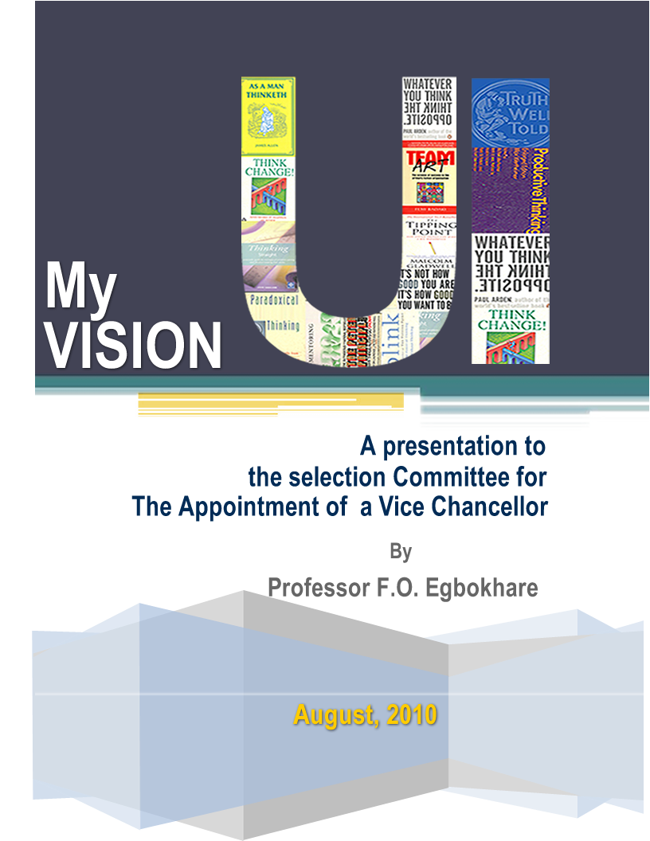


♬
♩
♪
♫
THE RAMIFICATIONS OF THE USE, ABUSE AND MYSTIFICATION OF TONES
♬
♫
The place of tone in dialects, news reportage, communication and research
Francis O Egbokhare
15/8/2020

Slide 2
Objectives
Understanding the relationship between pitch, tone and intonation.
Why are tones important?
How should we approach research into tone languages?
Overcoming the limitations of teaching tones

Slide 3
The Mystery of Tone
“A Missionary candidate and his wife once admitted that when they learned that the language of their African field was a tone language, they seriously questioned whether the Lord had actually called them to missionary service... A shocking number of people concerned with African languages still seem to think of tone as a species of esoteric, inscrutable, and utterly unfortunate accretion characteristic of underprivileged languages- a sort of cancerous malignity afflicting an otherwise normal linguistic organism…” (Welmers 1973:77).
The above statement may not be exactly representative today in terms of the growing attention and knowledge of tone languages. However, there is a carryover of the mindset in diverse ways. We reference tones differently, account for their behaviour with different terms.

Slide 4
Introduction: Basic Issues and Questions
Are the terminological and analytical differentiation of tones a matter of reality, nature, ideology, epistemology or phenomenology?
Epistemological issues: We are accustomed to seeing tones as an aberration. Therefore, we treat it differently from consonants and vowels.
Could this be due to the epistemology and phenomenological foundations of linguistics? Languages that provided data to the theoretical and analytical foundations of linguistics were largely non-tonal. They therefore conditioned the norms of perception and practices that framed linguistic study.

Slide 5
For instance:
No one imagines that actually occurring distinctive consonants and vowels should be omitted in writing. We sometimes advance reasons for omitting tones in writing.
We treat consonants and vowels as natural and tones as riding on some other units notwithstanding the fact that pitch generation is sequenced before resonance. Could pitch in fact be basic template for organizing the flow of speech? A kind of string on which consonants and vowels are beaded?
If we say that tones are suprasegmental, is it by their nature or by creation of theories, practice and conventions?
We talk of lexical and grammatical function of tones but never the lexical and grammatical function of consonants and vowels (It nuances tones as special in a negative sense).

Slide 6
Why do we treat tones differently?
It is quite seen as normal for a single consonant or vowel or their combination to be meaning bearing. We call them morphemes. We find it unusual or interesting to find tones that show similar behaviour. Sometimes, they pass unnoticed.
If a tone is meaning bearing, alone or in combination with other tones or segments, it raises a flag. A whao! moment.
Tones are represented as diacritics, unwittingly conventionalising the belief in their dispensability.
We have long consonants, long vowels, but not long tones. Why?
We can have vowel harmony or consonant harmony but never tone harmony.
We talk about level tones and contour tones, but not contour consonants and vowels in the cases of affricates, double articulation, secondary articulation, diphthongs, etc.(apologies to autosegmental phonology)

Slide 7
Can We Do Without Tones?
There are a number of arguments that often form the basis for disregarding tones in writing.
We don’t mark stress in English. Why should we mark tones? (A distinction between a culminative and distinctive property)
It is laborious to mark tones in text, especially where one has to mark more than one tone. For ease of writing, especially in in literary texts, we can ignore tones.
Marking tones is inelegant and harsh to the eyes. For ease of reading therefore, tones may be ignored.

Slide 8
But Some Fundamental Problems Are
Ideological issues in pronunciation (Anglicisation and Arabicisation, individual preferences, multiplicity of spelling systems)
Spelling and orthography masking (excessive divergences and lack of familiarity with conventions)
Accent prestige in enunciation (Americanisms and Eurocentrism)
Dialect override in standards adoption in the media (Tending to distort the true dialectal characteristics
Extreme diversity and consequences (500+ languages)
No spelling checkers, no pronunciation dictionaries
Poor attitudes towards indigenous languages

Slide 9
Tones Are Indispensable
We shall provide very basic reasons why marking or indicating tones should not be a matter of choice or convenience.
Minimal tonal pairs and sets (Yoruba Examples)
A lot of ambiguity and confusion in speech will be created by words, phrases and sentences that are differentiated by tones alone.

Slide 10
We Need to Pay Attention To Tones
Minimal Pairs (Mono-syllabic)
ká ‘pluck’
kà ‘count’
f́ ‘break’
f̀ ‘wash’
l# ‘go’
l̀ ‘grind’
Bisyllabic Minimal Pairs
i#gbá ‘calabash’
i#gba# ‘200’
ìgbà ‘time’
w́ ‘hand’
̀w̀ ‘respect’
w̀ ‘Broom’
gb̀↓ga↓́ ‘name of a place’
gb↓gà↓ ‘Hall’

Slide 11
SENTENCES
Adé kí ò8gá wa ‘Ade greeted our boss’
Adé ki ògá wa ‘Ade praised our boss’
Tolú fo8́ abó8 náà ‘Tolu broke the plate’
Tolú fo8 abo8́ náà ‘Tolu wash the plate’
Àjàyí fa igi náà ‘Ajayi pulled the plank’
Àjàyí fá igi náà ‘Ajayi shaved the plank’
TRISYLLABIC
̀kp̀l̀ ‘frog’
kpl ‘brain’
o#lódo# ‘dullard’
olódò ‘Owner of river’
olódó ‘ name of a place’
òdòdó ‘flower’
òdodo ‘truth’
kpátákò ‘ hoof’
kpátákó ‘plank’

Slide 12
b. Dialectal differentiation
c. Sociolinguistic and indexical meanings (pidgin)
somethîng bottôm
sómething bottom
d. Mispronunciation of place and personal names
Okóró ókōro
e. Ideological issues; accent prestige, standards, etc.
Reading difficulties
For native speakers reading texts
Foreign language learners
Road signs and user guides
Forensic value of tones
AI and NLP tools in tone languages (Google map in a tone language)
Poetry construction and enjoyment
Puns and word games

Slide 13
A PERSPECTIVE ON PITCH, TONE AND INTONATION
Although we perceive sounds as discrete, from acoustic studies, we can see that it is difficult to draw boundaries between sounds.
Pinker (1995) describes speech as an illusion and phonetic perception as a sixth sense.
Slicing of speech (Zellig Harris 1941, Absolute Slicing hypothesis)

Slide 14
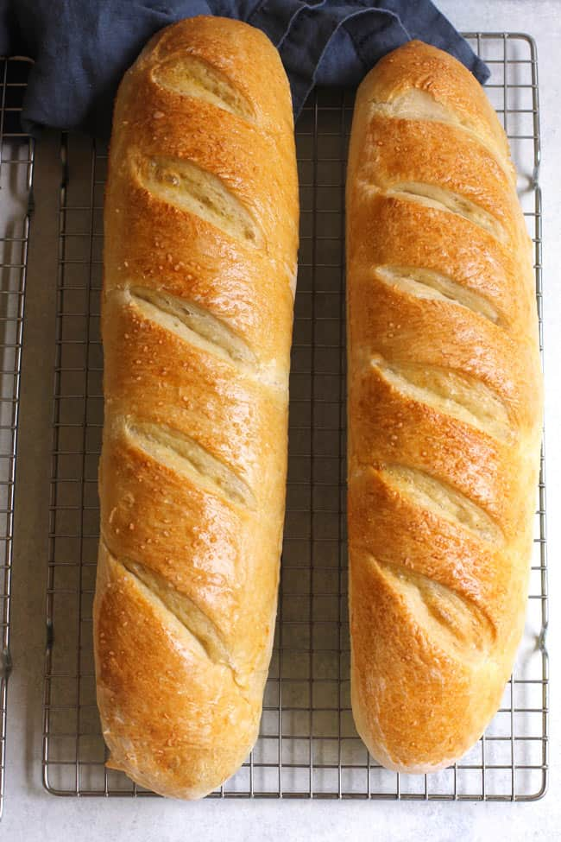
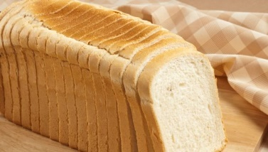
Slicing of Speech

Slide 15
Pitch Topography: Gradient and modulation or contours
There are two basic aspects of pitch which are universal. Pitch occurs in every language as melody and fluctuation or transitions. We describe these here as gradient and transition. They characterise the pitch topography and form the speech melody as we perceive it.
Pitch occurs as a melody of transitions and gradient.
Languages exploit either of the two or their combinations for the purpose of communication.

Slide 16
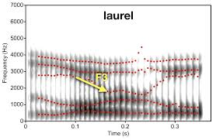
Yanny/Laurel Illusion Explanation ...wraplab.co
Emai Yes-no Question and Statement contour
Phonetics | Question | Statement
ú | 175.3 | 155.8
b | 162.9 | 139.2
é | 185.1 | 147.9
l | 188 | 148.8
é | 191.6 | 151.3
n | 196.5 | 156.2
ɔ́ | 206.2 | 146.9
ì | 139.8 | 104

Slide 17
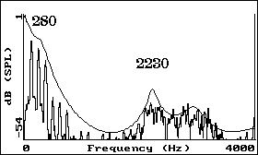
Frequency Representation
Fig.4: Frequency representation

Slide 18
EMAI Statement and Yes-No Curves

Slide 19
Pitch Aspect: Gradient and transitions
Two types of languages broadly speaking.
Pitch-centric languages, otherwise called tone languages. Pitch or tonality is the dominant property for the slicing and construction of speech arrangement, organization or construction.
Non-pitch centric languages.
Languages make a selection of the following aspects of pitch:

Slide 20
Primary and secondary aspects
Primary Aspects
Gradience: Gradient dominant languages utilize level tones
Pitch undulation or transitions: Transition dominant languages utilize contour tones
Gradient properties: no of tones, height of tones
Gradience integrity: stable-discrete level; unstable or variable-terrace level, global and local decline
Transition properties: types of contours, rising, falling, combinations
Gradience + transition: differentiation of contours by height, differentiation of level tones by transitions, basic level+contour, basic contour+level.
Secondary Aspects
Pitch Space/ Tone Area: area around which pitch moves, minimum and maximum pitch range which helps to define the unique tone levels and contour fluctuations, upper limits, lower limits. The tone levels are defined within the frequency ranges of individual languages.
Collocational features. The dimensions of combinations with other segments, effect of consonants and vowels, combinations with stress, loudness and vowel quality to produce prominence
Slurring Properties: the behaviour of tones that refer to the habits of pronunciation that are language specific.

Slide 21
Function of tone
The distinctive property of pitch, the extent to which it affects meaning.
Functional vs non-functional pitch
Functional: lexical and grammatical
Intrinsic and extrinsic lexical/grammatical (pitch may be marginal to grammatical or indispensable)

Slide 22
Domains
The domain of assignment of pitch varies and may influence the characteristics and typology of tone languages. A number of distinctions which we make between typologies of tone languages depends on the domain to pitch is assigned in the formation of meaning.
Syllable domain. Tone is assigned to every syllable. Pitch is cut or fit to size the syllable. Every syllable gets it and so based on the number of levels or transitions, we have multiplicity of combinations (Yoruba is a good example). Tone may only be sensitive to syllable types, variation and classification (eg., heavy and light syllables)

Slide 23
Domains
Morpheme or lexical domain. Pitch cut to fit morphemes or lexical unit. Tone is sensitive to morpheme classifications and categories. Following diversities are possible:
Free variable pattern. All possible combinations of tones are not exhausted. We may have a rise or fall prescribed as aggregate of the tonal combinatorial output freely for all morphemes depending on characteristics such as morpheme length or complexity or noun class (Bantu languages).
Fixed variable pattern. A defined tonal combination is restricted to specific morpheme classes (eg., LH for numerals, L L verbs, LHn and HnLn but not *Hn in Nouns in Emai)
Phrasal domain. Tone is assigned to a phrase (NP tones in Emai)
Clausal domain. Intonation.
Stand-alone tones with meaning (tonal morphemes)
Tonal-complexes with meaning (combinations of level tones at a distance)

Slide 24
NOTE
Intonation can be achieved from the aggregation of tone bits in the formation of the rhythm of speech, or
The stretching of pitch over domains larger than the morpheme
Meaning and function in the definition of tones and intonation is not material of their nature but incidental on the domains of structure on which pitch is mapped.
Essentially, both tones and intonation are same property, different only in the structural configuration in their application.

Slide 25
Functional Load and Collocation
Functional Load
Heavy lexical functional load, light grammatical functional load
Light lexical functional load, heavy grammatical functional load
Mixed combinations
Pitch Collocations
Consonant and vowels
Stress (pitch modulation, segment quality, intensity)
Accent (Cumulative, syntagmatic)
Pitch accent (overt attribute realized)
Stress Accent (Overt attribute realized)

Slide 26
TEACHING AND RESEARCH: WHAT ARE THE ISSUES?
Approaching the research situation
Generating topics and fields from the challenges observed
Innovating products and services to resolves linguistic problems
Teaching tones in Discrete and Terraced Systems
Puns, Word games and sensitivity to pitch and tone levels
Tone deafness

Slide 27
Conclusion
So much to do
Wetin I sabi?

Slide 28
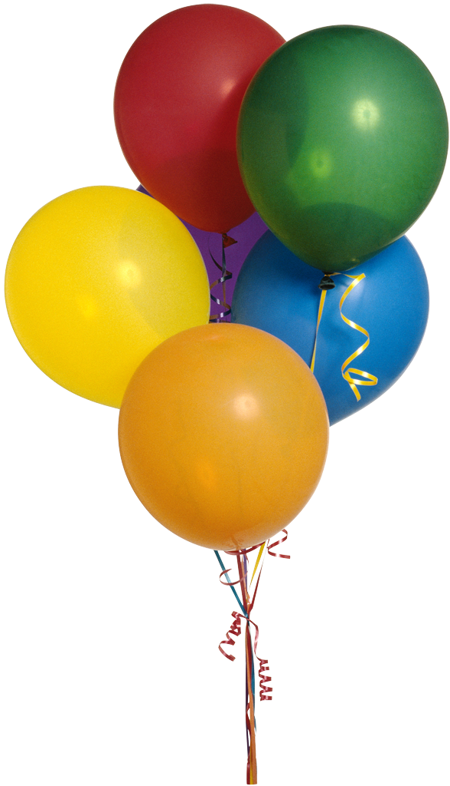
Ai Tank Una
Notes:
I-can Team; I_{nfo}-city

