Slide 1
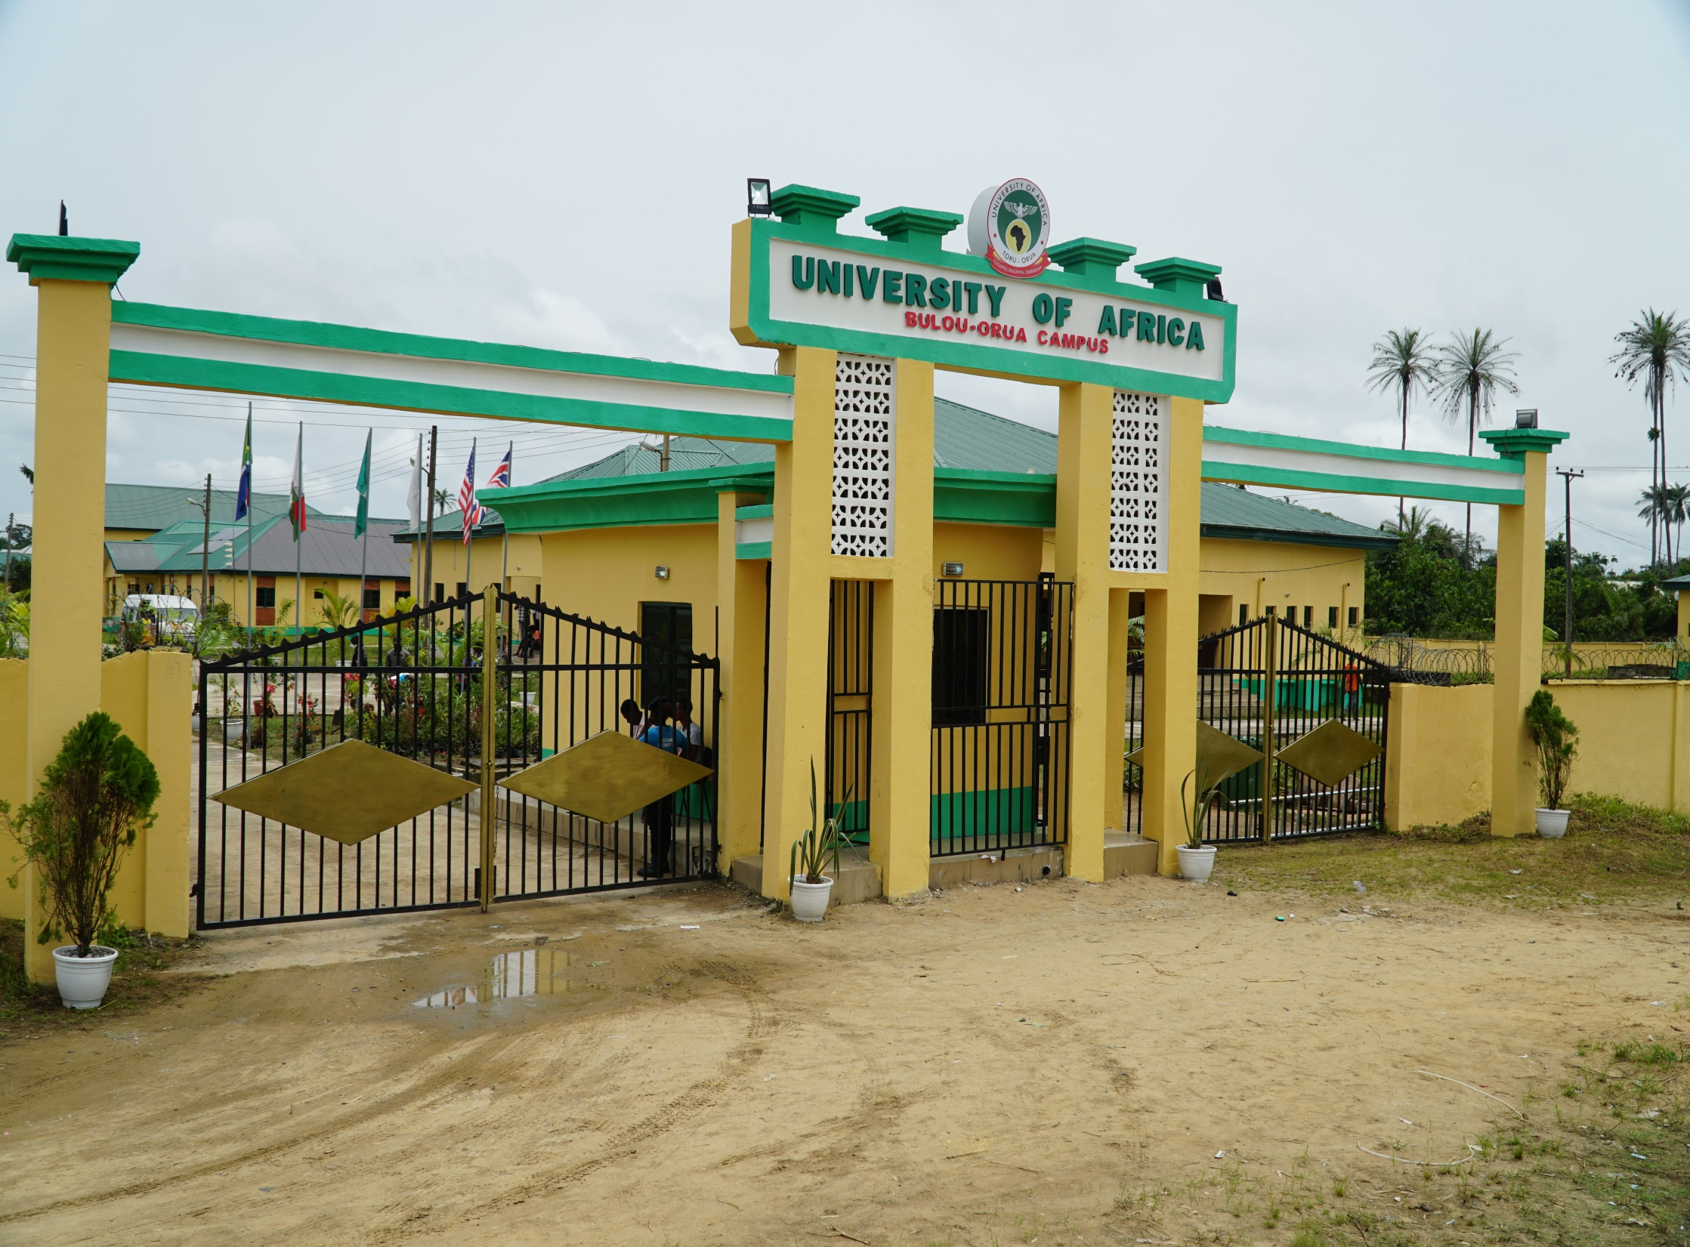

Slide 2
WHAT IS COMPUTER OR ACOUSTIC OR SPECTROGRAPHIC ANALYSIS AND HOW CAN THIS BE DONE IN RESEARCH?

Slide 3
BY
'DEMOLA JOLAYEMI
PhD cum laude, MNAL
(Professor of English & Digitised Linguistics)
And
The Dean, Faculty of Arts and Education
demola.jolayemi@uat.edu.ng

Slide 4
WHAT IS COMPUTER ANALYSIS?
OR
WHAT IS ACOUSTIC ANALYSIS?
OR
WHAT IS SPECTROGRAPHIC ANALYSIS?
AND
HOW CAN THIS BE DONE IN RESEARCH?

Slide 5
COMPUTER/SPECTROGRAPH
(IC) ANALYSIS
OR
ACOUSTIC ANALYSIS
AND
HOW CAN THIS BE DONE IN RESEARCH?

Slide 6
COMPUTER/SPECTROGRAPH
M-A-C-H-I-N-E-S
What we analyse are
Signals!
signals!!
signals!!!

Slide 7
ACOUSTICS (ANALYSIS)
This is concerned with
SOUND!
SOUND!!
SOUND !!!
signals
And there are over 50 of such
signals: Aero, Animal, Aqua,
Bio, Med, Music, Psycho, Electro, Speech...
A-C-O-U-S-T-I-C-S

Slide 8
ACOUSTICS (ANALYSIS)
This is concerned with
SOUND!
SOUND!!
SOUND !!!
signals
And there are over 50 of such signals: Aero, Animal, Aqua, Bio, Med, Music, Psycho, Electro, SPEECH
A-C-O-U-S-T-I-C-S

Slide 9
ACOUSTICS (ANALYSIS)
Speech Acoustics Analysis
OR
Acoustics Phonetic Analysis
Speech Sound Signals
OSCILLOGRAMS
SIGNALS
SPECTROGRAMS
R
E
S
E
A
R
C
H

Slide 10
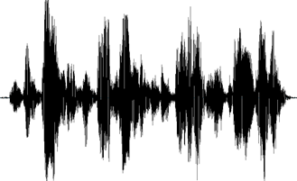
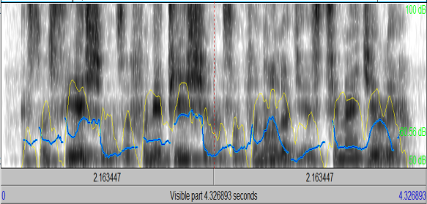
COMPUTERS, OSCILLOGRAMS, SPECTROGRAMS, FOR SPEECH ACOUSTICS ANALYSIS AND RESEARCH

Slide 11
COMPUTERS
Hardware
Laptops
Desktops
Palmtops
Notebooks
Handsets
Etc.
Software
(for speech acoustics)
Audacity
PRAAT
WaveSurfer
WASP
SFS
Speech Analyzer
lingWAVES
Etc.

Slide 12
SOME SPEECH PHYSICS TERMS
Acoustics
Waves & Oscillograms
Fundamental Frequency (F0)
Harmonics
Formants
Amplitude
Intensity
Spectrograms

Slide 13
SOME SPEECH PHYSICS TERMS
Acoustics: This a branch of
physics that deals with the
study of mechanical waves in
the production and propagation
of sounds. It also has to do with
sound-based concepts such as: vibrations, resonances,
infrasounds and ultrasounds.

Slide 14
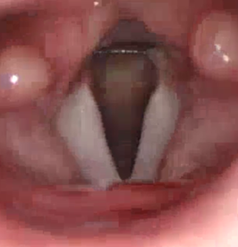
2) Waves
Major vehicle that transports sounds from one point to the other. It’s displacement of pressure in the physical materials (gases, liquids or solids) causes sounds. Here, it’s called Speech Sound Waves, activated by the Vocal folds.

Slide 15
2b) Waves
in speech acoustics Periodic: Repeat themselves
result in vowel & voiced
Waves consonant sounds
Aperiodic: Don’t Repeat
themselves
result in voiceless consonant
sounds, noises, and pauses

Slide 16
2c) Waves - Oscillogram
Registration or presentation of waves.
In the forms of spikes, excursions or waveforms of the sound waves. Speech oscillograms are generated by measuring computer software: PRAAT, SFS, WASP, LINGwaves, Speech Analyzer, Audacity, etc.

Slide 17
2c) Waves - Oscillogram
From a speech oscillogram, you can read or see long excursions representing high amplitude sounds such as the vowel and voiced consonant sounds.
Inversely, you can also read or see short or no excursions representing voiceless sounds, noises or pauses.

Slide 18
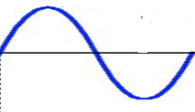
SOME SPEECH PHYSICS TERMS
3) Fundamental Frequency (F0):
A simple wave (sinusoidal) produced
by a single oscillation.
Gives the tone (pitch) that we hear.
Measured in Hertz (Hz).
Also called speech curves, sine waves,
or waveforms.

Slide 19
SOME SPEECH PHYSICS TERMS
4) Harmonics:
A multiple of sine waves in
their repetitive manner of the continuous oscillation.
There are harmonics in every
multiple occurrence of the
vibrating waves.
They represent the acoustic
energy of a sound in gray or dark colour across the
spectrogram of the sound.

Slide 20
SOME SPEECH PHYSICS TERMS
5) Formants:
This is a function of the harmonics.
But here, the acoustic energy is
concentrated on particular
frequencies of the sounds.
This is owing to the sound
resonances occasioned in the
vocal tract, which differentiate the individual voices.
Formants occur at an interval of 1000/1100Hz.

Slide 21
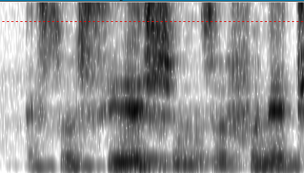
Spectrogram: Harmonics
& Formants
Source: Jolayemi (September, 2020).
Insight. APPN

Slide 22
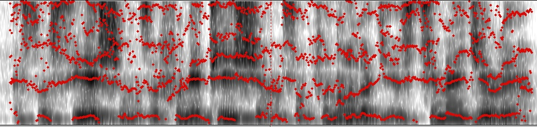
5b) Formants:
On many vowel sounds, there is an
average of 3 formants: F1, F2 and F3.
They appear as very dark bands or
curves from below the spectrograms.
Occur only in voiced speech sounds.
Source: Jolayemi (September, 2020).
Insight. APPN

Slide 23
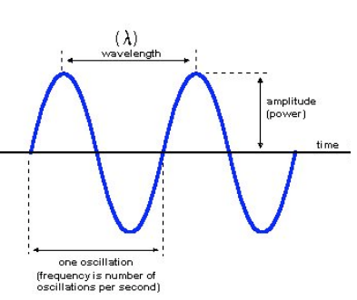
SOME SPEECH PHYSICS TERMS
6) Amplitude:
This is the height of vibrating (sound)
waves that represents the loudness of
the sound.
It’s across the vertical line of the
waveforms.
It’s measured in Decibels (Db)
Source:
https://byjus.com/physics/waves/

Slide 24
SOME SPEECH PHYSICS TERMS
7) Intensity:
This is also the function
of the amplitude.
It translates the rate of
acoustic energy flow
of a sound (how intense).
It is represented by curves
on the sound spectrogram.

Slide 25
SOME SPEECH PHYSICS TERMS
8) Spectrogram:
The slate on which acoustic
information is written, read and
interpreted.
The spectra presentation and
analysis of acoustic signals that
project all the physics speech
terms explained above, apart
from the oscillogram.
Below are the spectrograms of:
Elizade University and
Babcock University.

Slide 26
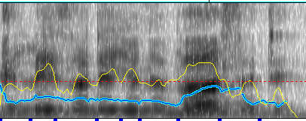
SPECTROGRAM OF:
“ELIZADE UNIVERSITY”
Source: ‘Demola Jolayemi, p. 20. English Language Teaching Today, Dec 2013, 10(1), 12-21. https://www.researchgate.net/publication/275340562_DOING_PHONETICS_WITH_COMPUTER_INTRODUCING_PRAAT_AND_ITS_APPLICATION_TO_PHONOLOGY_OF_ENGLISH

Slide 27
SPECTROGRAM OF:
“BABCOCK UNIVERSITY ILISHAN”
Source: Jolayemi & Oyinloye, p. 25. International Journal of Linguistics and Communication, June 2019, 7(1), 17-28
http://ijlcnet.com/journals/ijlc/Vol_7_No_1_June_2019/3.pdf

Slide 28

SEPCTROGRAM OF “ASSOCIATION OF
PHONETICIANS AND PHONOLOGISTS
IN NIGERIA” (APPN)
Source: Jolayemi (September, 2020).
Insight. APPN

Slide 29
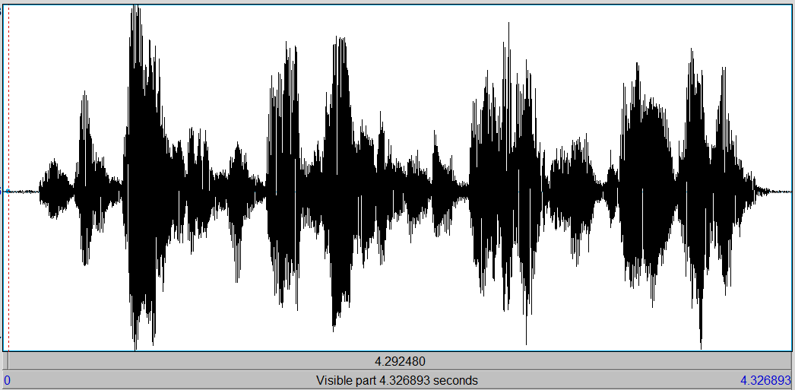
OSCILLOGRAM OF: “ASSOCIATION
OF PHONETICIANS AND
PHONOLOGISTS IN NIGERIA” (APPN)
Source: Jolayemi (September, 2020).
Insight. APPN

Slide 30
RESEARCH IMPLICATIONS OR
APPLICATIONS
Provision of Acoustic evidence for:
Syntax: Types of Sentences
Pragmatics: Utterance verification
Semantics: Disambiguation

Slide 31
RESEARCH IMPLICATIONS
OR APPLICATIONS
Acoustics Investigations into:
Autosegmental Features:-
Intonation Pattern
Stress Pattern
Tone Pattern
Pauses
Silence
By taking the readings of the:
F0s (in Htz)
Intensity (in Dbs)
Duration (in Secs)

Slide 32
RESEARCH IMPLICATIONS
OR APPLICATIONS
Acoustics Investigations into:
Segments:-
Vowels
Voiced Consonants
Voiceless Consonants
Voice Onset Time (VOT)

Slide 33
REAL-TIME
DEMONSTRATION
USING
PRAAT

Slide 34
SUMMARY
I have made efforts to tell:
what computer or acoustic
or spectrographic analysis is;
and how it can be done in research, illustrating with 7 self-generated oscillograms & spectrograms. I hope you have made some sense out of it. I also hope I have sufficiently confused you to want to run to the next book and url on speech acoustics!!! THANK YOU

Slide 35
Refs, Some Books, Persons & URLs to Consult
Fry, DB. 1979. The physics of speech. Cambridge: CUP.
Jolayemi, ‘Demola. (2006). Stress pattern of Nigeria English: An experimental phonology approach. Gottingen, Germnay: Cuvillier Verlag.
UNILAG: Segun Awonusi
UI, Ibadan: Adenike Akinjobi, AB, Sunday, Bunmi Oyatokun
OAU, Ile Ife: Taiwo Soneye, Biyi Adejuwon
OSUN: Aduke Akindele
St Augustine UNI: Emmanuel Osifeso
https://www.researchgate.net/publication/275340562_DOING_PHONETICS_WITH_COMPUTER_INTRODUCING_PRAAT_AND_ITS_APPLICATION_TO_PHONOLOGY_OF_ENGLISH
http://ijlcnet.com/journals/ijlc/Vol_7_No_1_June_2019/3.pdf
https://byjus.com/physics/waves/

